Slide 1
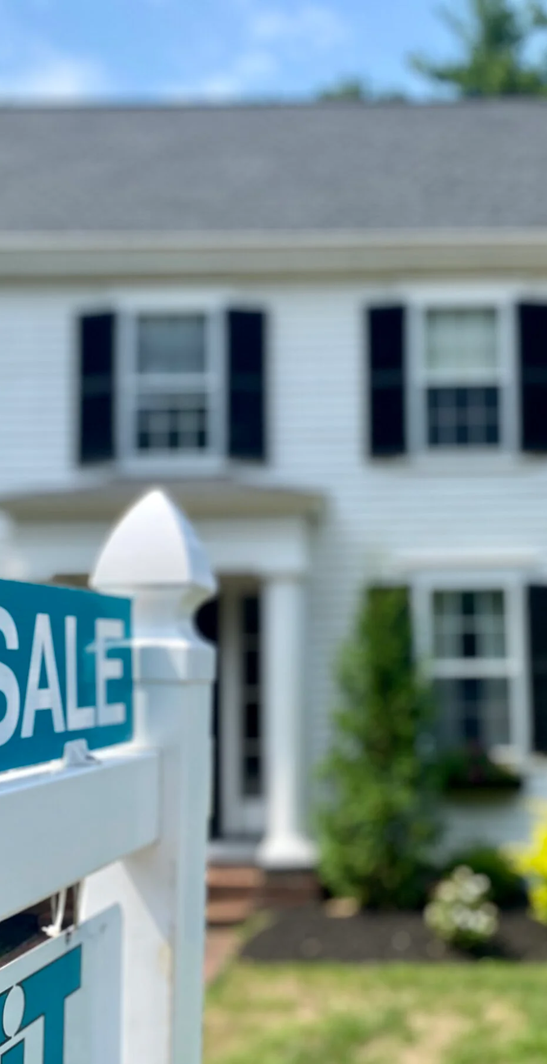
BOSTON HOUSE PRICES
PABLO ALFARO
DAVID CARRASCOSA
CAMILO MERCADO

Slide 2
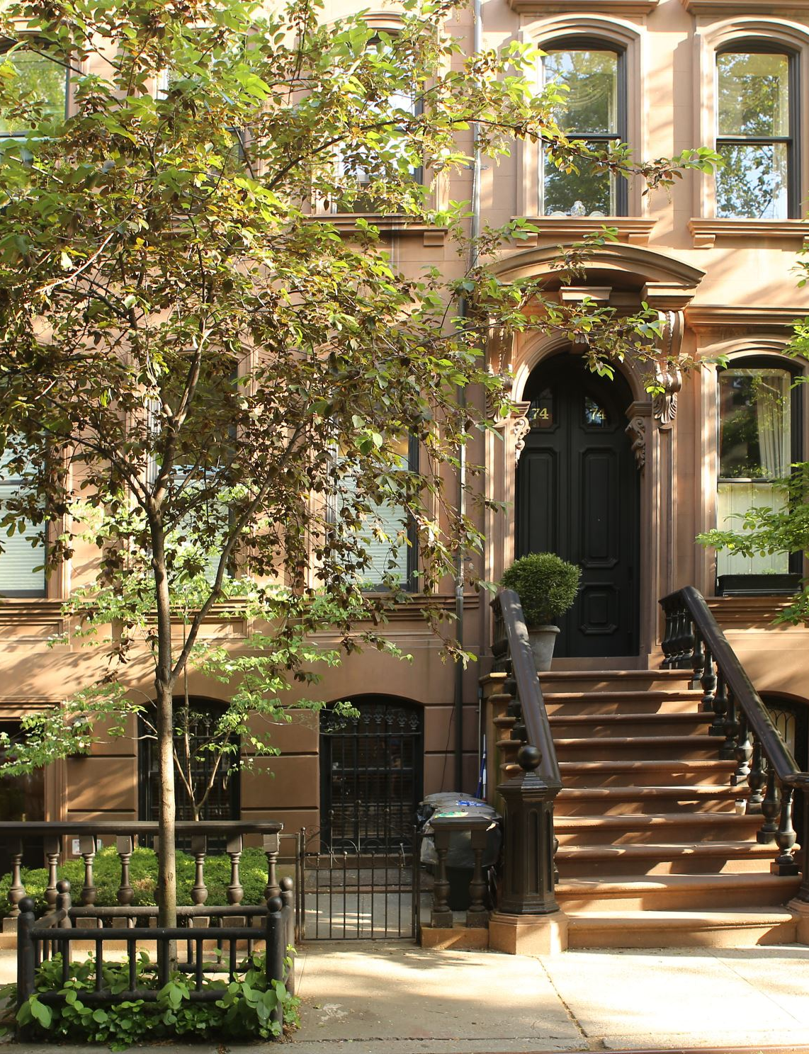
OUR DATASET
Input features in order:
1) CRIM: per capita crime rate by town
2) ZN: proportion of residential land zoned for lots over 25,000 sq.ft.
3) INDUS: proportion of non-retail business acres per town
4) CHAS: Charles River dummy variable (1 if tract bounds river; 0 otherwise)
5) NOX: nitric oxides concentration (parts per 10 million) [parts/10M]
6) RM: average number of rooms per dwelling
7) AGE: proportion of owner-occupied units built prior to 1940
8) DIS: weighted distances to five Boston employment centres
9) RAD: index of accessibility to radial highways
10) TAX: full-value property-tax rate per $10,000 [$/10k]
11) PTRATIO: pupil-teacher ratio by town
12) LSTAT: % lower status of the population – LSTAT represents the percentage of the population in a given area that is classified as lower status, typically indicating those with lower income and education levels.
Output variable:
1) MEDV: Median value of owner-occupied homes in $1000's [k$]
506 observations & 14 features

Slide 3
Our Stakeholders
Real Estate investors & Property Developers
Home Buyers & Sellers
City Planners & Government Agencies
The population of Boston

Slide 4
Question #1
Are there any anomalies or extreme outliers that may distort analysis?

Slide 5
CLEANING THE DATASET

Slide 6
BEFORE ERASING OUTLIERS
Summary | MEDV
Count | 506
Mean | 22.533
Stddev | 9.197
Min | 5.0
Max | 50.0
Skewness | Kurtosis
1.105 | 1.469

Slide 7
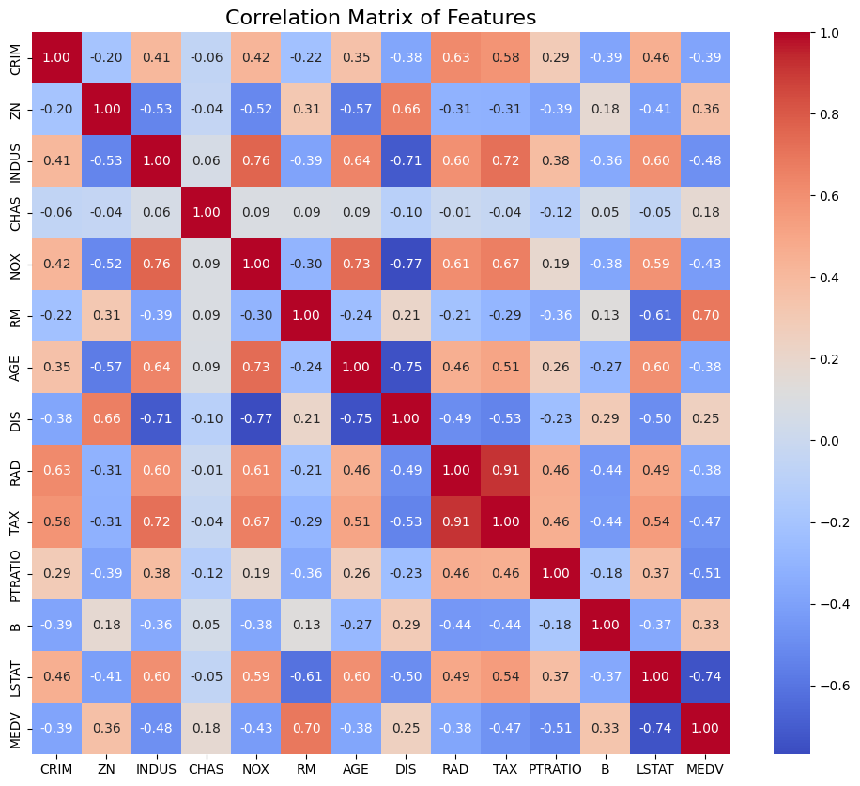
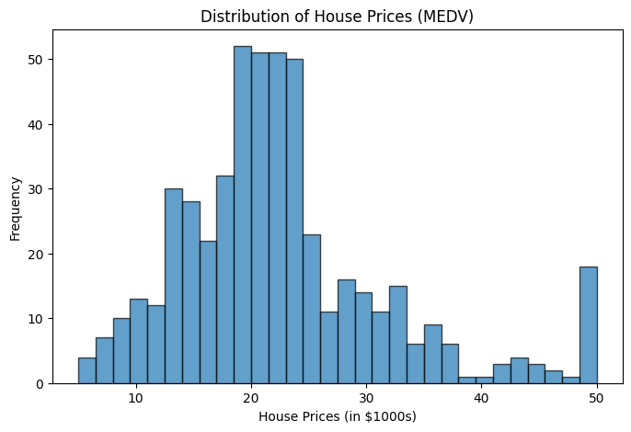
CORRELATION & DISTRIBUTION

Slide 8
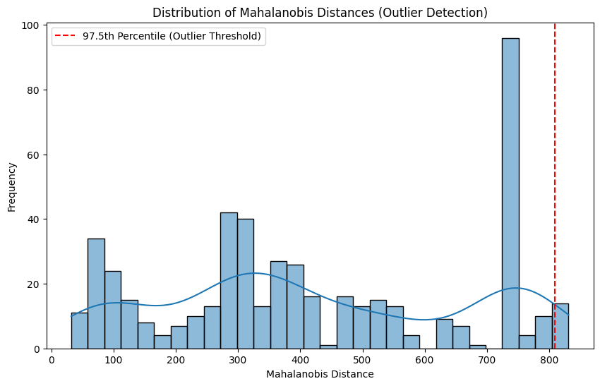
AFTER ERASING OUTLIERS
Summary | MEDV
Count | 483
Mean | 22.796
Std | 9.153
Min | 5.0
Max | 50.0
Skewness | 1.11
Kurtosis | 1.47

Slide 9
Answer #1
No significant outliers were detected based on Mahalanobis Distance.

Slide 10
Question #2
What factors most influence housing prices in Boston?

Slide 11
Question #3
Can we accurately predict house prices using Machine Learning Models?

Slide 12
PCA SCREE PLOT

Slide 13
Hybrid Stepwise SELECTION
Forward selection (Adding features)
Backward elimination (Removing features)
Final model performance
R² Score: 0.7406
Adjusted R² Score: 0.7338)
Removed Features:
RAD: index of accessibility to radial highways

Slide 14
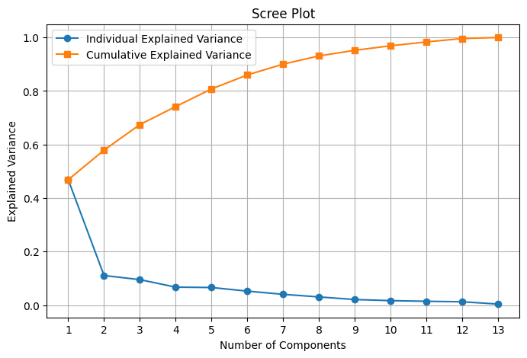
SCREE PLOT
6 components >= 90% variance

Slide 15
Linear regression & Hyperparameter Tuning

Slide 16
Best Linear Regression model
Linear Regression
RMSE Evaluator
K-Fold (5 folds)
MEDV | Prediction
5.0 | 11.10
8.40 | 7.66
10.40 | 6.90
10.90 | 14.28
RMSE: 4.85
R² Score: 0.74
Adjusted R² Score: 0.68
MAE: 3.50

Slide 17
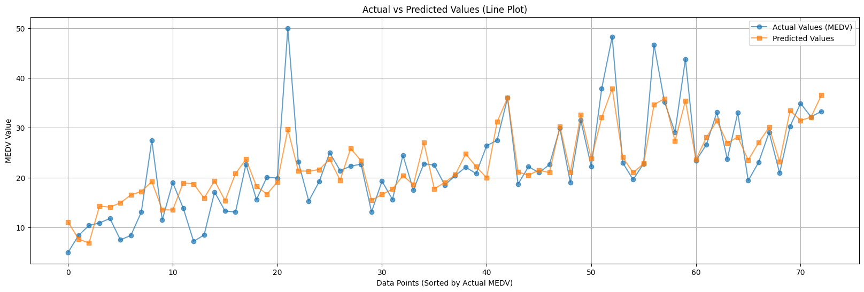
Actual VS Predicted Values

Slide 18
Random Forest Regressor

Slide 19
Improved model parameters
Improved model metrics
Number of trees: 150
Max Depth: 12
Max Bins: 40
Min Instances per Node: 2
RMSE 4.03
R² Score: 0.82
Adjusted R² Score: 0.80
MAE: 2.95

Slide 20
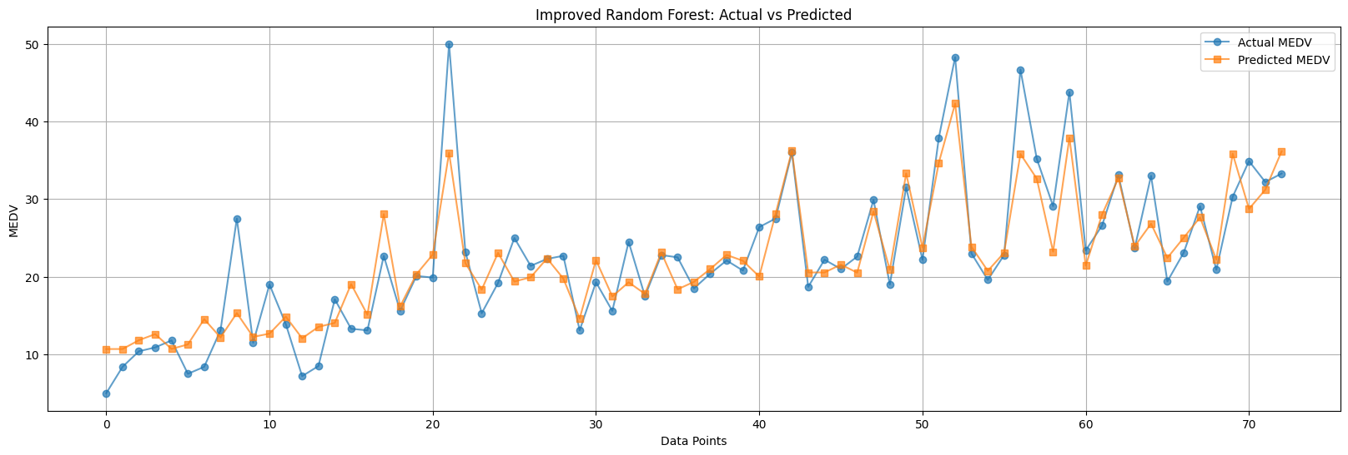
Actual VS Predicted Values

Slide 21
Linear Regression VS Random Forest
Increment
RMSE: 4.85
R² Score: 0.74
Adjusted R² Score: 0.68
MAE: 3.50
RMSE 4.03
R² Score: 0.82
Adjusted R² Score: 0.80
MAE: 2.95
RMSE: -16.9%
MAE: - 15.7%
R² Score: 10.8%
Adjusted R² Score: 17.6%

Slide 22
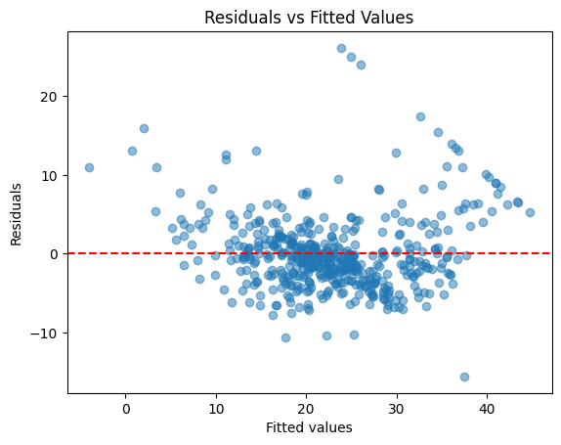
Linear Regression
No homoscedasticity
Independence assumption violated

Slide 23
Answer #2
Top 5 most influential factors:
Per capita crime rate by town (0.31)
Proportion of non-retail business acres per town (0.23)
Nitric oxides concentration (0.16)
Average # of rooms per dwelling (0.10)
Proportion of residential zoned for lots over 25K sq.ft (0.10)

Slide 24
Answer #3
Yes, The model achieves high accuracy with an Adjusted R² above 0.75

Slide 25
Question #4
Can we segment neighborhoods into meaningful clusters based on Socio-Economic and Environmental factors?

Slide 26
KMeans Clustering

Slide 27
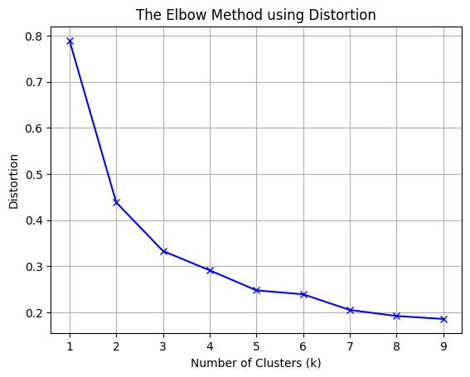
Finding optimal number of clusters
Plots within-cluster-sum-of-square WCSS
for each amount of clusters
Find “elbow” for optimal number of clusters

Slide 28
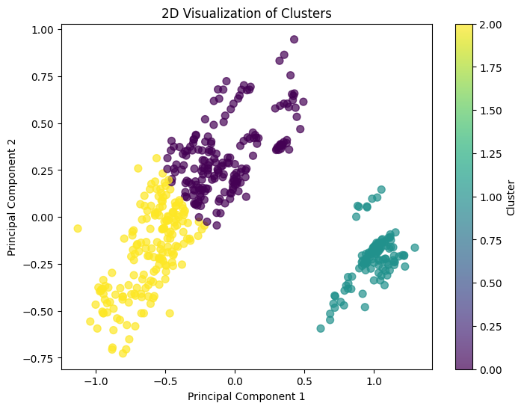
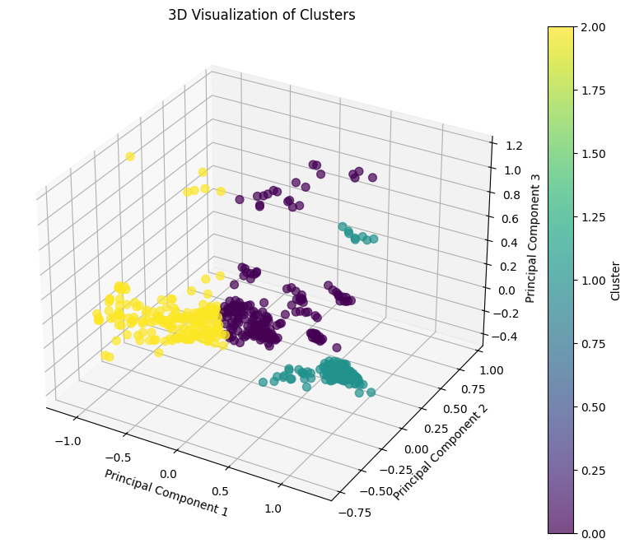
PCA 2 variables
PCA 3 variables

Slide 29
Answer #4
Can we segment neighborhoods into meaningful clusters based on Socio-Economic and Environmental factors?
 | CRIM | ZN | INDUS | CHAS | NOX | RM | AGE | DIS | RAD | TAX | PTRATIO | B | LSTAT
Cluster 0 | 0.668046 | 1.87E+00 | 11.648925 | 0.112903 | 0.575753 | 6.24 | 83.814516 | 3.007044 | 4.677419 | 332.048387 | 17.97043 | 372.765215 | 13.388763
Cluster 1 | 12.594989 | 1.67E-14 | 18.1 | 0.064516 | 0.672629 | 6.016435 | 89.808065 | 2.057778 | 24 | 666 | 20.2 | 306.383065 | 18.554758
Cluster 2 | 0.104925 | 2.95E+01 | 5.139945 | 0.032787 | 0.446895 | 6.538437 | 37.069945 | 5.899011 | 4.229508 | 291.47541 | 17.645355 | 389.455628 | 7.397432
1) CRIM: per capita crime rate by town
3) INDUS: proportion of non-retail business acres per town
5) NOX: nitric oxides concentration (parts per 10 million) [parts/10M]
7) AGE: proportion of owner-occupied units built prior to 1940
8) DIS: weighted distances to five Boston employment centres
12) LSTAT: % lower status of the population

Slide 30
Question #5
How do different features correlate with house prices?

Slide 31
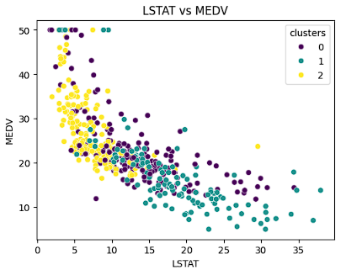
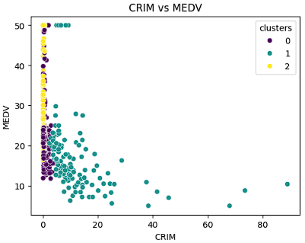
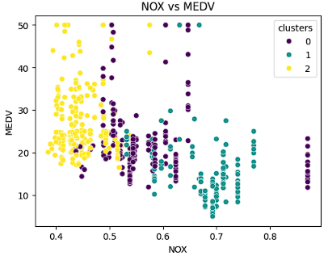
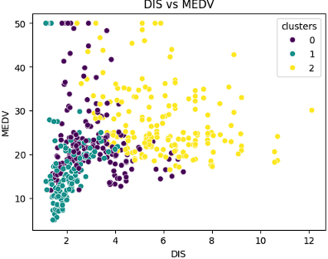
Visual Correlations
1. Crime Rate
2. Socio-Economic Factors
4. Pollution
3. Accessibility
DIS: weighted distances to five Boston employment centres

Slide 32
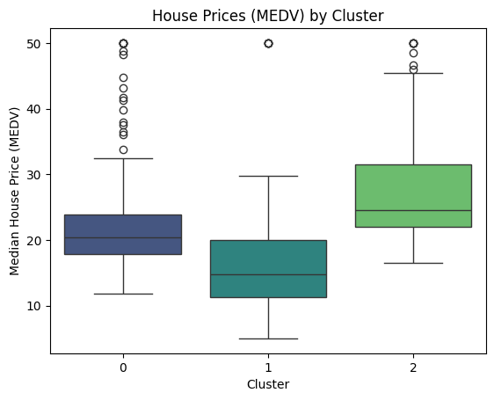
House prices for each cluster

Slide 33
Question #6
How can policymakers use data to improve housing conditions in underdeveloped neighborhoods?

Slide 34
Cluster 1 – Low-income
Cluster 2 - Wealthy
Cluster 0 – Middle Class
Crime Rate: Very High (12.59)
Industrial Proportion: High (18.1)
Nitric Oxides: High (0.67)
Rooms: Small (6.01)
Residential Land Zoned: Zero
Crime Rate: Very Low (0.10)
Industrial Proportion: Low (5.14)
Nitric Oxides: Low (0.44)
Rooms: Large (6.54)
Residential Land Zoned: High (29.52)
Crime Rate: Moderate (0.66)
Industrial Proportion: Moderate (11.65)
Nitric Oxides: Moderate (0.57)
Rooms: Medium-Sized (6.24)
Residential Land Zoned: Very low (1.87)

Slide 35
Insights from analysis & Recommendations
1. Crime rate: Higher crime rates leads to lower house prices
Invest in public safety programs
Establish neighborhood watch programs
Invest in youth programs
2. High pollution levels: Pollution impacts housing conditions
Implement pollution control measures
Increase and protect green spaces
Promote clean energy in industrial zones

Slide 36
Insights from analysis & Recommendations
3. Accessibility: Poor accessibility affects housing desirability.
Improve public transportation
Reduce local property tax
Invest in infrastructure
4. Socio-Economic Barriers: Lower-Status population correlates to lower house prices
Invest in educational programs
Develop job training and employment initiatives
5. Underdeveloped housing features: Fewer rooms lead to lower house prices
- Provide low interest loans for home improvements

Slide 37
Targeted Focus
Real Estate Investment
Urban Planning
Policy Development
Focus on Cluster 2 or 0 for stable Investments
Address main issues for Cluster 1
Target Cluster 1 for Socio-Economic Uplift

Slide 38
Answer #6
Expected Outcomes:
Improved Public Safety
Better Enviromental Conditions
Enhanced Accessibility
Socio-Economic Uplift
Higher Property Values

Slide 39
Thank You!

